Slide 1


Its Senior Year, so…

Slide 2




Post-High School Options
College
  2-year community college
  4-year college or university
Technical/Trade School
  Shorter training times, can be more expensive.
  Lots of choices (electrician, ironworker)
  Earn while you learn
  Many construction trades
  NNACA https://www.buildingtradejobs.org/
  Military
  Army, Navy, Air Force, Marines
  Coast Guard, Army and Air Guard.
  ASVAB (Vocational Aptitude Battery)
Work
  On-the-Job Training
Stop in the Career Center for college and career assistance!!

Slide 3
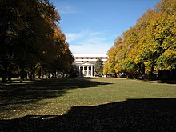
College Exploration
Common Data Set
Princeton Review
Tours

Slide 4
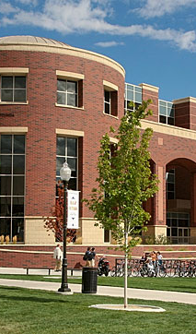
Applying for College
Check Deadlines & MEET deadlines
UNR
  Admissions open September 1, 2023
  Early Action deadline: November 15, 2023
  Freshman application deadline for Fall 2024: April 8, 2024
UC schools
  Admissions open August 1
  Fall 2024 admission application filing period for all: October 1-November 30, 2023
  applicants.https://admission.universityofcalifornia.edu/how-to-apply/applying-as-a-freshman/dates-and-deadlines.html
Apply early for better service; some colleges offer early consideration, including UNR.
Apply for scholarships and financial aid.
  Some schools will have separate application.
  You will need to complete the FAFSA form after January 1 2024.

Slide 5
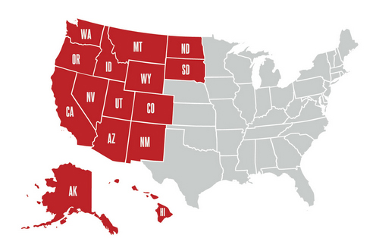
WUE
Western Undergraduate Exchange https://www.wiche.edu/tuition-savings/wue/
Students can enroll in participating college programs at a reduced tuition rate
Considerably less than nonresident tuition
Apply for WUE through the school you plan to attend.
Some schools require that you complete a separate form, while others simply have you check a box on their general university application form.
Some schools exclude high-demand majors from participating in WUE.

Slide 6
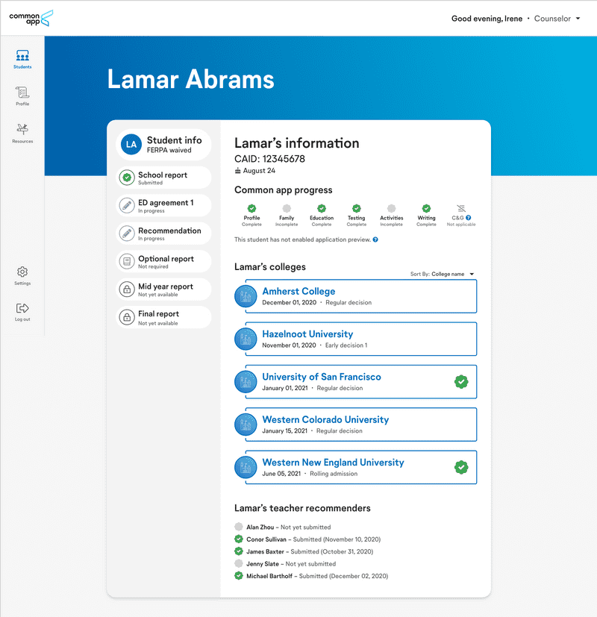
Common App
Navigate your entire college application journey with Common App.
www.commonapp.org
COVID-19 Impact section
Home - Common Data Set

Slide 7
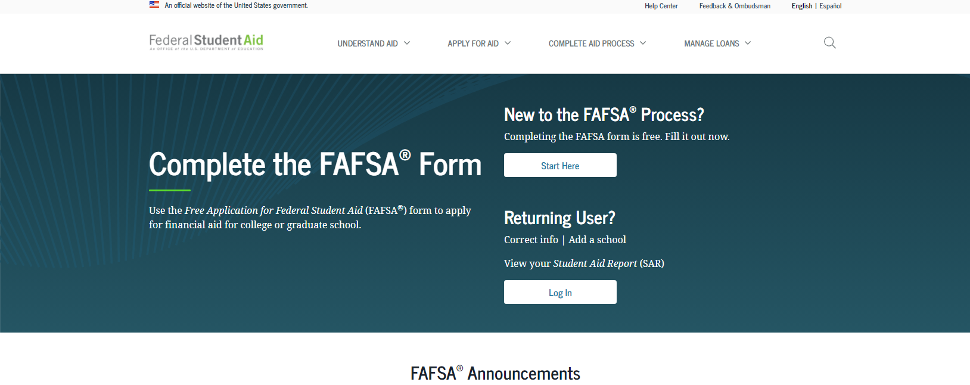
Financial Aid www.fafsa.ed.gov
FAFSA stands for Free Application for Federal Student Aid
Fill it out… the earlier the better!!
The 2024–25 FAFSA® form will be available in December 2023, not Oct. 1
Use the 2023–24 FAFSA® form to apply for college financial aid for 7/1/23–6/30/24.
Please reach out to our College & Career Center for information about upcoming Parent Workshops for assistance

Slide 8
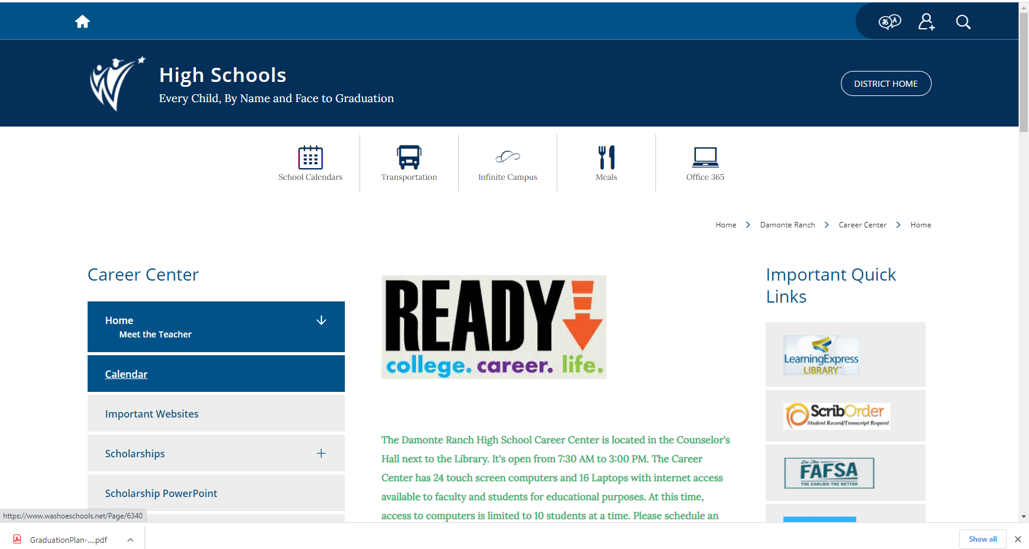
DRHS Scholarship Opportunity
www.washoeschools.net/drhscareercenter
Damonte Ranch HS In- House Scholarship: Opens October 31
and closes January 19, 2024 @ 3pm sharp.
https://www.washoeschools.net/Page/9640
Apply here:
https://forms.office.com/Pages/ResponsePage.aspx?id=SfWsPDZezEGj3olFnhId7xLfOqtZRyBAqyyE7mkHZmtUM0dHSDQ4Nk5aRks1TFVaUTBMUDNGVkc2VC4u

Slide 9
Nevada Promise Scholarship
How it Works
As a last-dollar scholarship, the Nevada Promise Scholarship covers the cost of the registration and mandatory fees not covered by other gift aid
  Tuition is not charged to residents of Nevada.
Gift aid is defined as
  a Federal Pell Grant
  a Federal Supplemental Educational Opportunity Grant (FSEOG)
  a Silver State Opportunity Grant (SSOG)
  a Governor Guinn Millennium Scholarship (GGMS).
The Nevada Promise Scholarship can provide funding for a student for up to three years.
  Oct 31 Application is Due
  https://bit.ly/nshe-nv-promise-app

Slide 10
Nevada Promise Scholarship (continued)
Planning to attend a 2-year college:
  College of Southern Nevada (CSN)– Las Vegas
  Great Basin College (GBC)- Elko
  Truckee Meadows Community College (TMCC)- Reno
  Western Nevada College (WNC)- Carson City
Resident of Nevada
High School Diploma
Enroll in 12 semester credits towards Associate’s Degree or Certificate program of study
Meet all deadlines
  Application deadline- no later than 11:59pm on October 31, 2024
  Training deadline- no later than March 1, 2024
  FAFSA deadline- no later than April 1, 2024
  8 hours of eligible community service no later than May 1, 2024
  Mentor Meeting- meet by July 1, 2024

Slide 11
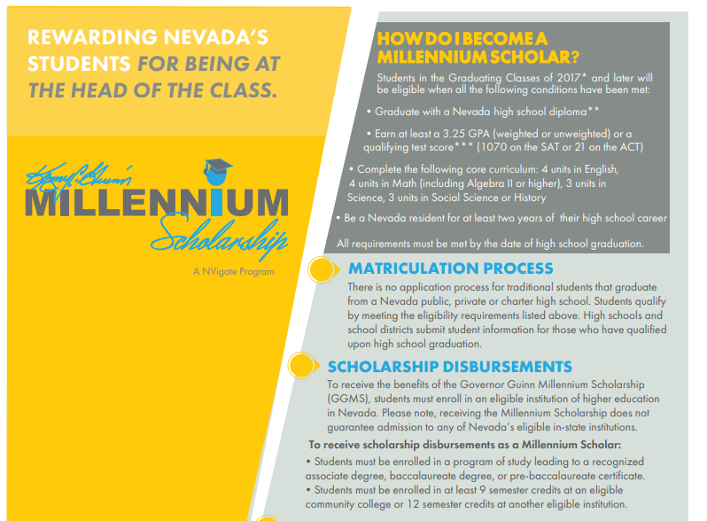
The Millennium Scholarship https://www.nevadatreasurer.gov/GGMS/GGMS_Home/

Slide 12
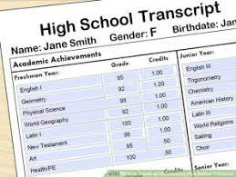
Transcripts
WCSD Student Accounting no longer allows counselors to print/send copies of student transcripts.
All Transcripts must be requested by visiting
  www.washoeschools.net/drhs
  Click on Quick Links
  Click on Transcripts
ScribOrder will send your transcript to your identified college/university
  First 4 transcripts are free
  $10 per transcript after the 4th transcript
  Pro Tip:
    Send yourself a copy so that you can send out unofficial transcripts until you’ve narrowed your search
    Send official copies later to those schools to which you’ve narrowed your selection

Slide 13
Letters of Recommendation
Many colleges/universities will ask for a recommendation
See Mr. Cabada for assistance on creating/updating your Academic Resume to help with Letters of Recommendation and scholarships.
Ask a staff member who knows you well
  Teacher, Coach, Counselor, Administrator
Give 2 weeks advance notice
  Many students ask the same people for recommendation letters, so you’ll need to give them time to complete them
Provide a resume/brag sheet about yourself
  This gives the staff member information about you that you would like them to include in the letter

Slide 14
NCAA Clearinghouse https://web3.ncaa.org/ecwr3/
IS YOUR GOAL TO PLAY
COLLEGIATE SPORTS?
START PLANNING NOW!!
NAIA
www.naia.org
NAIA (National Association of Intercollegiate Athletics) to participate in athletics
2.3 GPA for recent graduates
or
Meet 2 of 3 following criteria:
  2.0 GPA
  Rank in top 50% of grad class
  ACT- 18; SAT 970
Complete NAIA Profile
Upload transcripts to NAIA portal
NCAA (National Collegiate Athletic Association) clearinghouse to participate in Division I or II sports
16 Core credits
2.3 Core GPA
SAT combine score or ACT sum score matching core course GPA
Edgenuity is not accepted by the NCAA.

Slide 15
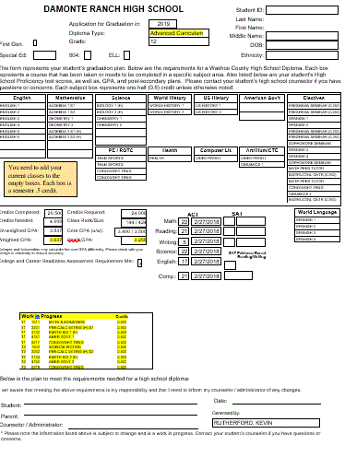
DRHS Graduation Plans

Slide 16
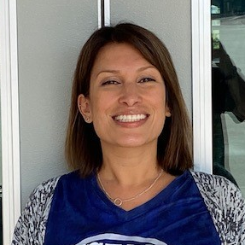
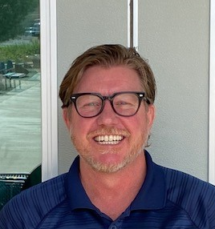

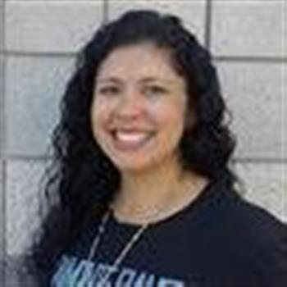
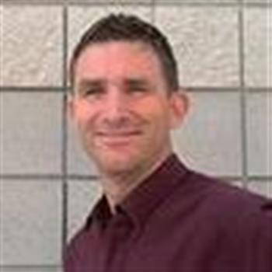


Have a GREAT YEAR!
See your counselor in the Counseling office or Mr. Cabada in the College & Career Center with any questions you may have!
Ms. Lazear
A-C
Mr. Woodard
D-Hi
Ms. McColl
Ho-Mi
Ms. Barnard
Mo-Sa
Mr. Schreiner
Sc-Z
Mr. Cabada
College & Career Center
Mr. Hughes
Safe School Professional

